Slide 1





CULMINATING PERFORMANCE TASK IN GENERAL MATHEMATICS
Presentation by Group 4

Slide 2



REAL-LIFE APPLICATION OF EXPONENTIAL FUNCTIONS
EXPONENTIAL
DECAY
helps in finding the rapid decrease over a period of time i.e. population decay, half-life, radioactivity decay, etc

Slide 3


CONTENTS
Objectives
Introduction of the three (3) radioactive substances
Uses and effects of the three (3) radioactive substances
Exponential Decay Models
Demos Graph of the three (3) radioactive substances
References

Slide 4


OBJECTIVES
To make an exponential decay model of each substance
Solve for the exponential decay of the three (3) substances
Solve for the half-lives of the three (3) substances
Understanding the concept of exponential function through exponential decay model table of values

Slide 5
WHAT IS
RADIOACTIVE SUBSTANCES?
Can be described by the exponential decay model. The decay of a radioactive substance follows an exponential function that represents the decrease in the quantity of the substance over time.
Radioactive substances are materials that contain unstable atomic nuclei, leading to the spontaneous emission of ionizing radiation. These substances are characterized by the presence of isotopes whose atomic nuclei undergo radioactive decay.

Slide 6
HALF-LIFE
A term commonly used in the context of radioactive decay and refers to the time it takes for half of a substance to undergo decay or transformation. This concept is particularly significant for radioactive isotopes, where the decay process follows an exponential decay model.

Slide 7


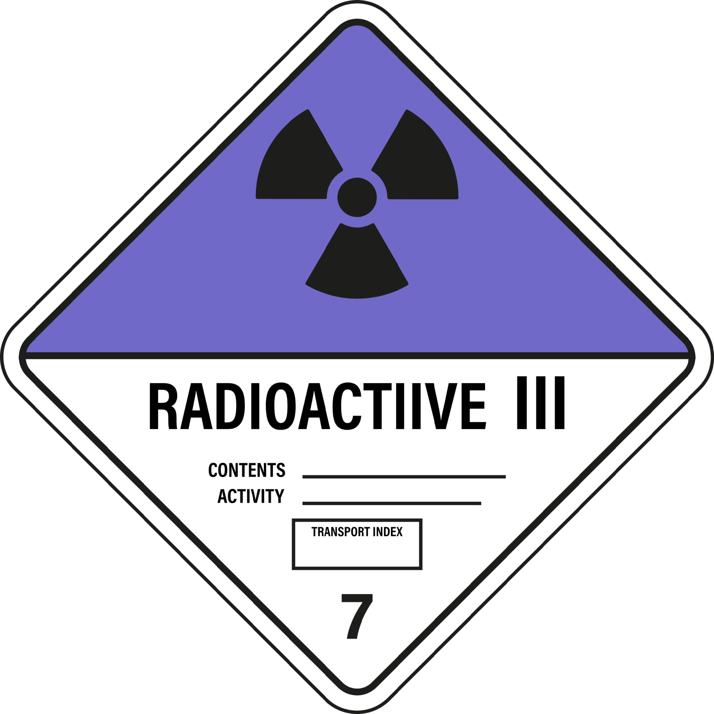


RADIOACTIVE SUBSTANCES
(Ra) Radium-226
(Am) Americium-241
(Ra) Californium-251

Slide 8

RADIOACTIVE SUBSTANCES
(RA) RADIUM-226
Half-life: 1600 years
Uses:
Used in luminous paint (in the form of radium bromide).
Used in medicine to produce radon gas, used for cancer treatment.
At the beginning of the 19th century radium was used as additive in products like toothpaste, hair creams and even food items.
Used to produce radon, a radioactive gas used to treat some types of cancer
Radium-226 was also mixed with fluorescent zinc sulfide to make a luminous paint. This luminous material was used to paint timepieces

Slide 9
RADIOACTIVE SUBSTANCES
(RA) RADIUM-226
Half-life: 1600 years
Effects:
Exposure to higher levels of radium over a long period can lead to death and other severe health problems.
Levels of radium can cause cancer (especially bone cancer), anemia, a problem with the blood; fractured teeth and cavities, and growths in the eyes called cataracts.
Radium exposure has resulted in acute leukopenia, necrosis of the jaw, and other effects.

Slide 10
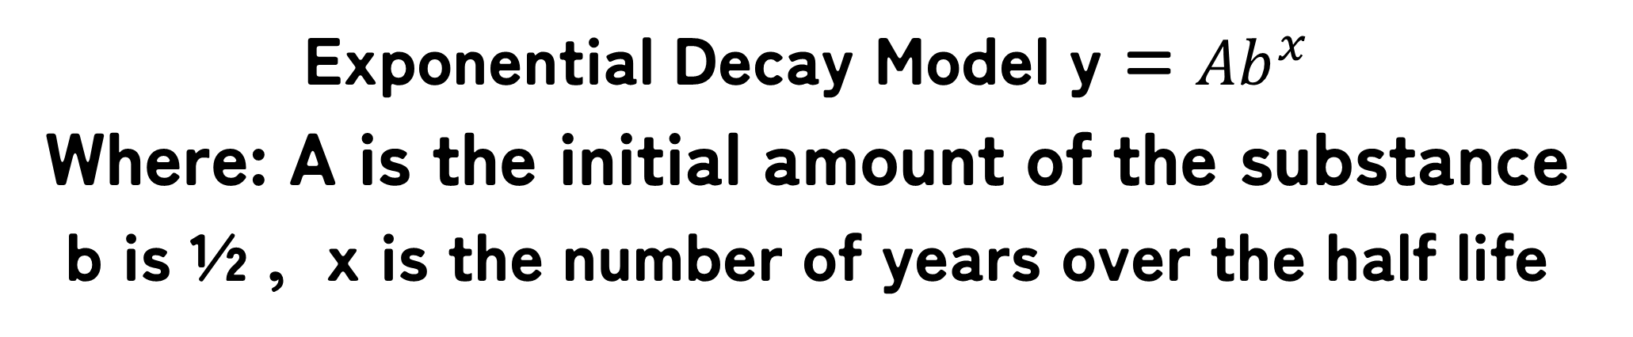
1st Radioactive Substances
(RA) RADIUM-226
Half-life: 1600 years
EXPONENTIAL DECAY MODEL
Exponential Decay Model y = ${Ab}^{x}$
Where: A is the initial amount of the substance
b is ½ , x is the number of years over the half life

Slide 11

Exponential Decay Model
IDENTIFY THE GIVEN VALUES:
Radioactive substance: (Ra) Radium-226
Half-life: 1600 years (x)
Initial Amount: 300grams (A)
SUBSTITUTE:
$y = 300{\left(\frac{1}{2}\right)}^{\frac{x}{1600}}$
TABLE OF VALUES
x (years) | 0 | 1600 | 3200 | 4800 | 6400
y (amount of substances) | 300 | 150 | 75 | 37.5 | 18.75

Slide 12

Guide Question:
Given radium-226 with initial amount of 300 grams and half-life of 1600 years. What is the remaining amount in 4800 years?
TABLE OF VALUES
x (years) | 0 | 1600 | 3200 | 4800 | 6400
y (amount of substances) | 300 | 150 | 75 | 37.5 | 18.75
Guide Question: Answer
Remaining amount of radium-226 in 4800 years is 37.5 grams.

Slide 13
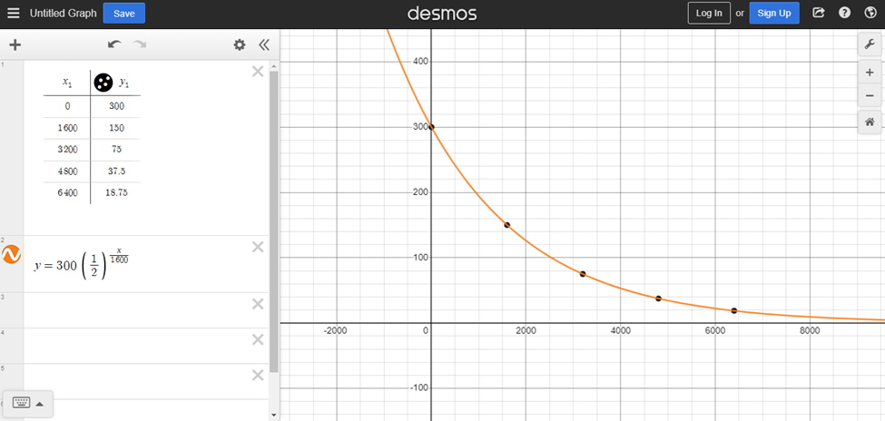
The demos graph of the 1st substance
(RA) RADIUM-226

Slide 14
RADIOACTIVE SUBSTANCES
(AM) AMERICIUM-241
Half-life: 432.2 years
Uses:
Used in some medical diagnostic devices and in a variety of industrial and commercial devices that measure density and thickness.
Has been used to provide passive diagnosis of thyroid function.
In ionization chamber smoke detectors makes the air in the detector's sensing chamber conduct electricity.

Slide 15
RADIOACTIVE SUBSTANCES
(AM) AMERICIUM-241
Half-life: 432.2 years
Effects:
Inside your body, americium is concentrated in your bones, where it remains for a long time. The radiation given off by americium can change the genetic material of the bone cells and this could result in the formation of bone cancers.
Americium has not been found to cause cancer in humans. However, studies in animals have demonstrated that internal exposure to it can cause cancer in bone and liver, where americium is stored.

Slide 16

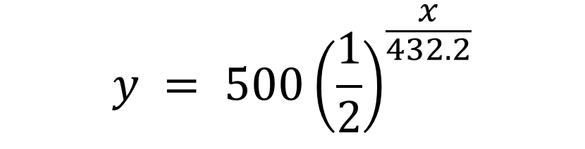
Exponential Decay Model
y = ${Ab}^{x}$
Where: A is the initial amount of the substance
b is ½ , x is the number of years over the half life
IDENTIFY THE GIVEN VALUES:
Radioactive substance: (Am) Americium-241
Half-life: 432.2 years (x)
Initial Amount: 500 grams (A)
SUBSTITUTE:
$$y = 500{\left(\frac{1}{2}\right)}^{\frac{x}{432.2}}$$
TABLE OF VALUES
x (years) | 0 | 432.2 | 864.4 | 1296.6 | 1728.8
y (amount of substances) | 500 | 250 | 125 | 62.5 | 31.25

Slide 17
Guide Question:
Given Americium-241 with initial amount of 500 grams and half-life of 432.2 years. What is the remaining amount in 864.4 years?
TABLE OF VALUES
x (years) | 0 | 432.2 | 864.4 | 1296.6 | 1728.8
y (amount of substances) | 500 | 250 | 125 | 62.5 | 31.25
Guide Question: Answer
Remaining amount of Americium-241 in 864.4 years is 125 grams.

Slide 18
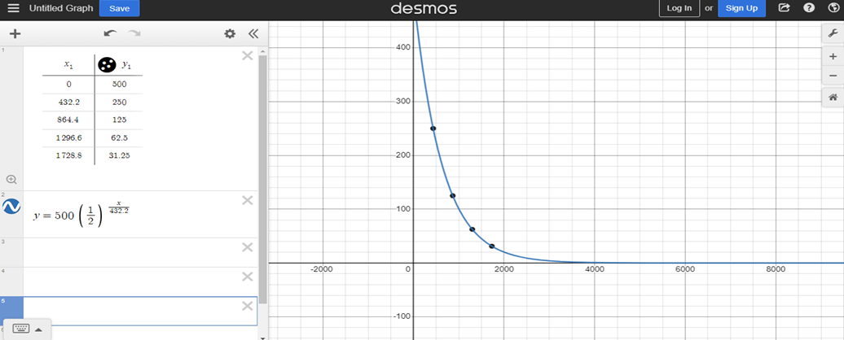
The demos graph of the 2nd substance
(AM) AMERICIUM-241

Slide 19
RADIOACTIVE SUBSTANCES
(RA) CALIFORNIUM-251
Half-life: 898 years
Uses:
It is used in portable metal detectors, for identifying gold and silver ores, to identify water and oil layers in oil wells and to detect metal fatigue and stress in aero planes
They can be used as neutron sources in nuclear weapons as well as nuclear reactors.

Slide 20
RADIOACTIVE SUBSTANCES
(RA) CALIFORNIUM-251
Half-life: 898 years
Effects:
Californium-251 can cause tissue damage externally, through gamma ray emission. Ionizing radiation emitted by californium on bone and in the liver can cause cancer.
Its greatest threat is damage to the gene pool, the genetic make-up of all living species. Genetic damage from radiation exposure is cumulative over lifetimes and generations.
The one in utero, and all that follow may suffer cancers, immune system damage, leukemias, miscarriages, stillbirths, deformities, and fertility problems.

Slide 21

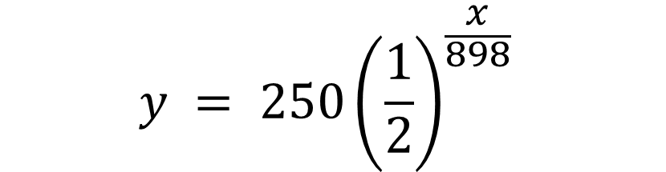
Exponential Decay Model
y = $Ab^{x}$
Where: A is the initial amount of the substance
b is ½ , x is the number of years over the half life
IDENTIFY THE GIVEN VALUES:
Radioactive substance: (Ra) Californium-251
Half-life: 898 years (x)
Initial Amount: 250 grams (A)
SUBSTITUTE:
$$y = 250{\left(\frac{1}{2}\right)}^{\frac{x}{898}}$$
TABLE OF VALUES
x (years) | 0 | 898 | 1796 | 2694 | 3592
y (amount of substances) | 250 | 125 | 62.5 | 31.25 | 15.625

Slide 22
Guide question:
Given californium-251 with initial amount of 250 grams and half-life of 898 years. What is the remaining amount in 3592 years?
TABLE OF VALUES
x (years) | 0 | 898 | 1796 | 2694 | 3592
y (amount of substances) | 250 | 125 | 62.5 | 31.25 | 15.625
Guide Question: Answer
Remaining amount of californium-251 in 3592 years is 15.625 grams

Slide 23
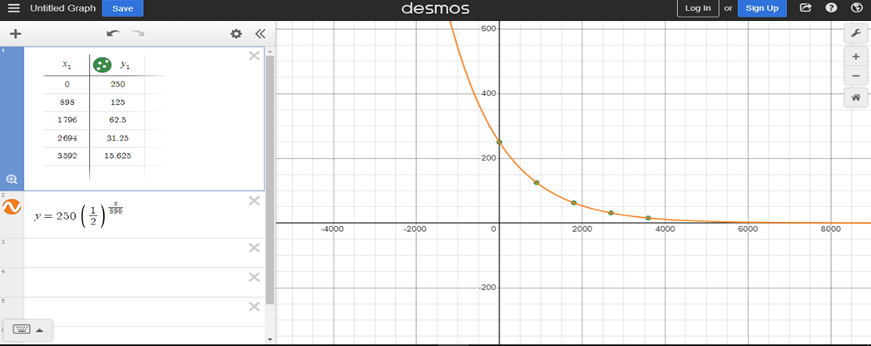
The demos graph of the 3rd substance
(RA) CALIFORNIUM-251

Slide 24
The demos graph of the three (3) different substances
(RA) RADIUM-226
(AM) AMERICIUM-241
(RA) CALIFORNIUM-251

Slide 25
REFERENCES
Choppin, G. R., Liljenzin, J.-O., & Rydberg, J. (2013). Radiochemistry and nuclear chemistry (4th ed.). Butterworth-Heinemann.
Martin, M., & Williamson, E. (2021). Nuclear and particle physics: An introduction (3rd ed.). John Wiley & Sons.
International Agency for Research on Cancer (IARC). (2012). Radium and its decay products. IARC Monographs on the Evaluation of Carcinogenic Risks to Humans, 100, 165-188.
Hedges, R. E. M., & Gowlett, J. A. J. (2003). Radiocarbon dating: Practical aspects. Oxford University Press.
National Cancer Institute (NCI). (2023, July 12). Radium exposure and cancer. https://www.epa.gov/sites/default/files/2016-09/documents/radionuclides.pdf
Agency for Toxic Substances and Disease Registry (ATSDR). (2004). Toxicological profile for americium. https://www.atsdr.cdc.gov/ToxProfiles/tp156.pdf

Slide 26
National Academies of Sciences, Engineering, and Medicine. (2020). Health risks from low levels of ionizing radiation: BEIR VII Phase 2. https://nap.nationalacademiesJanuar
Nuclear Regulatory Commission (NRC). (2023, January 17). Radioactive decay. https://www.nrc.gov/about-nrc/radiation/protects-you/reg-matls.html
US Environmental Protection Agency (EPA). (2022, March 2). Radionuclide basics: Americium-241. https://19january2017snapshot.epa.gov/radiation/radionuclide-basics-americium-241
Agency for Toxic Substances and Disease Registry (ATSDR). (2004). Toxicological profile for americium. https://www.atsdr.cdc.gov/ToxProfiles/tp156.pdf
International Atomic Energy Agency. (2006). Nuclear data services. https://www-nds.iaea.org/
National Cancer Institute. (2023, July 12). Radium exposure and cancer. https://www.nrc.gov/about-nrc/radiation/rad-health-effects.html
National Center for Biotechnology Information. (2019, July 24). Iodine-131. https://pubchem.ncbi.nlm.nih.gov/compound/Iodine-I-131
National Institute of Environmental Health Sciences (NIEHS). (2023, October 26). Americium. https://wwwn.cdc.gov/TSP/PHS/PHS.aspx?phsid=809&toxid=158

Slide 27

THANK YOU

